Slide 1
Let’s discover tide pools!
What is a tide pool?
Notes:
Ok! Let’s share about tide pools!
Raise your pointer finger if this is the first time you have ever heard about tide pools! Great! We will learn a lot today.
Now, hold up 2 fingers if you can tell us.. What do you think a tide pool is?
Has anyone here been to a tide pool…Can share some thing about what you saw?
Tide pools only show at certain times of the day, depending on the tides. (Talk about tides)

Slide 2
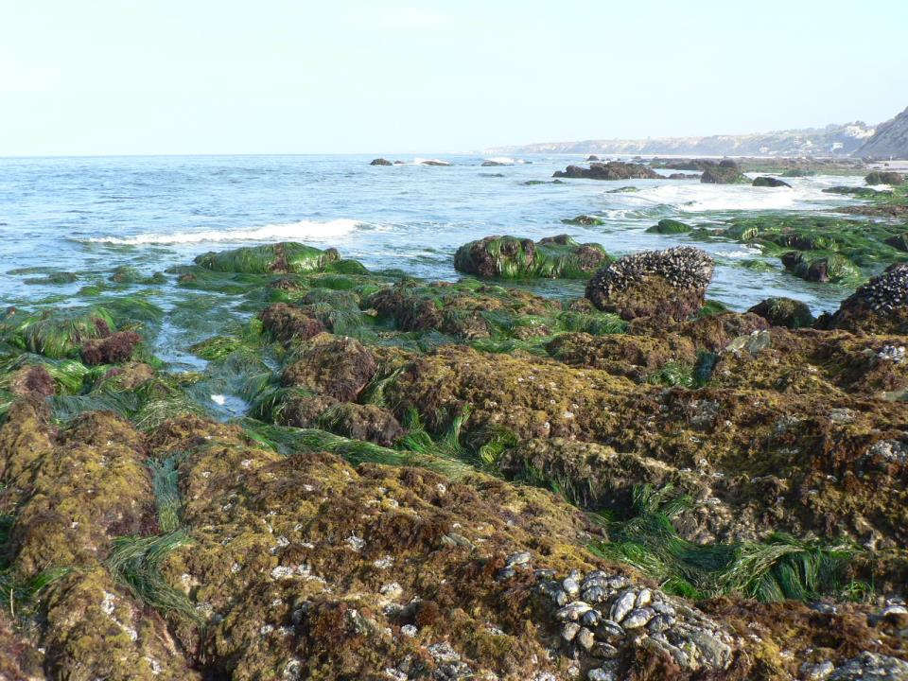
What ingredients help make a tide pool?
Sunlight
Ocean/Water
Rocks & Grass
Hint: Look at the 3 symbols in the tide pool picture.
Notes:
Tide pools are full of life. Sunlight supports life everywhere, and in tide pools too!
You can find tide pools where the ocean meets rocky shores, and when the tide is LOW, and away from the rocky shore.
Later, we can look at a Tide Table to see the best time to explore tide pools!

Slide 3
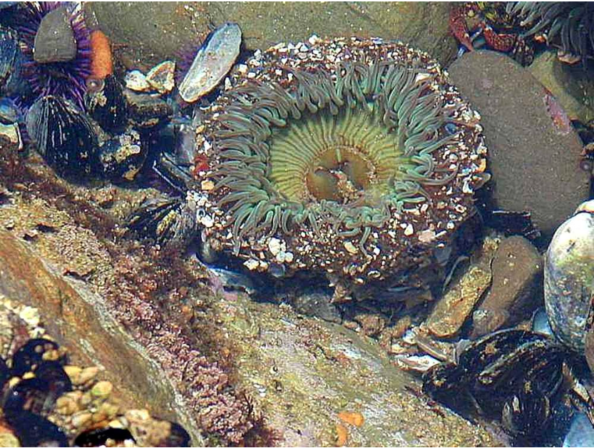
The main ingredient of a tide pool is…
Pools of water with sea life living inside!
Could you swim inside of these pools? Why or why not!
Notes:
Tide pools are the pools of water left behind when the tide goes out.
When the ocean is far away, and the tide is out, that is called…Low tide because there is only a little bit of water on the shore.
When the ocean covers the rocks, the tide is in. It is not called low tide, it is called….HIGH tide. We can’t see the pools at high tide.

Slide 4
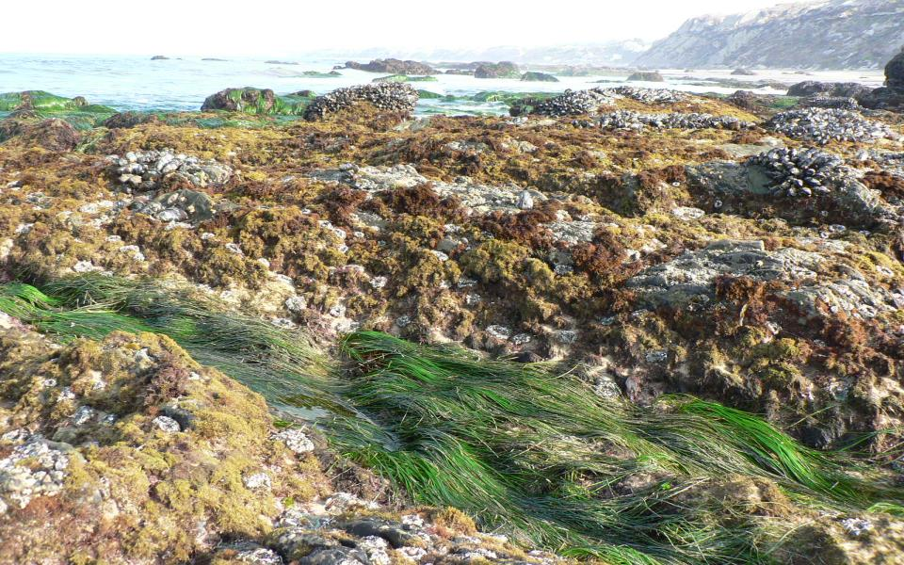
Pools can only be seen when the tide is…
LOW
and away from the rocky shore
Extra Challenge: What force regulates the tides?
Notes:
Tide pools are only seen during low tides.
The plants and animals that live in the tide pools are always there, even when the tide is high.
When the tide goes out, the moon is pulling it!
Tides are the rise and fall of ocean waters produced by the gravitational pull of the moon and the sun.

Slide 5
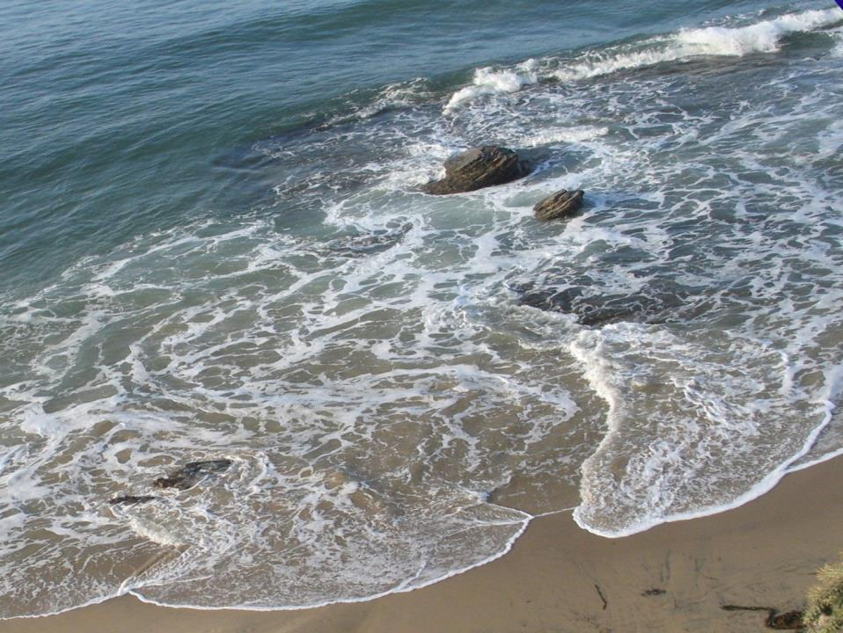
Life in a tide pool…
Is it Easy or Challenging?
Consider what you have learned so far.
Notes:
Analyzing new information: Help the kids think about what they know, and apply it to the sea animals in a tide ppol.(empathy and logic)
What things have you learned about tide pools? (Waves and water come in and out but the life is always there)
Leading question: If you had waves crashing all over you every day, what could you do to protect yourself?

Slide 6
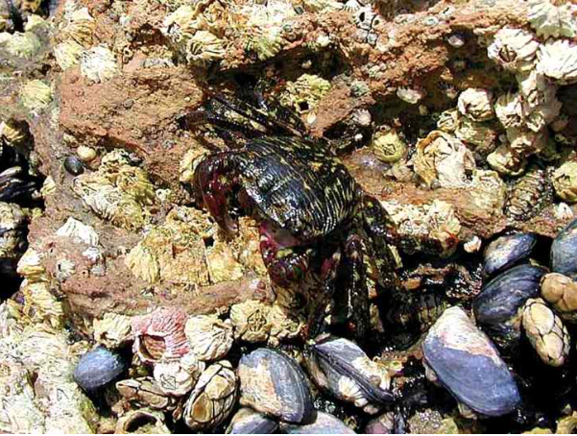
Plants & animals live in tide pools
How do I survive in my wavy environment?
Fact: Crabs and other Invertebrates like tide pools
Fact: Invertebrates have no backbone
Fish are vertebrates.
Notes:
Inquirty: Challenge answer: Invertebrates are animals with no backbone.
Question/Research topic: What other animals and plants live in tide pools?
Research: Use class handouts or internet search.
Further challenge: What animals in tide pools are vertebrates? (Answer: fish)

Slide 7
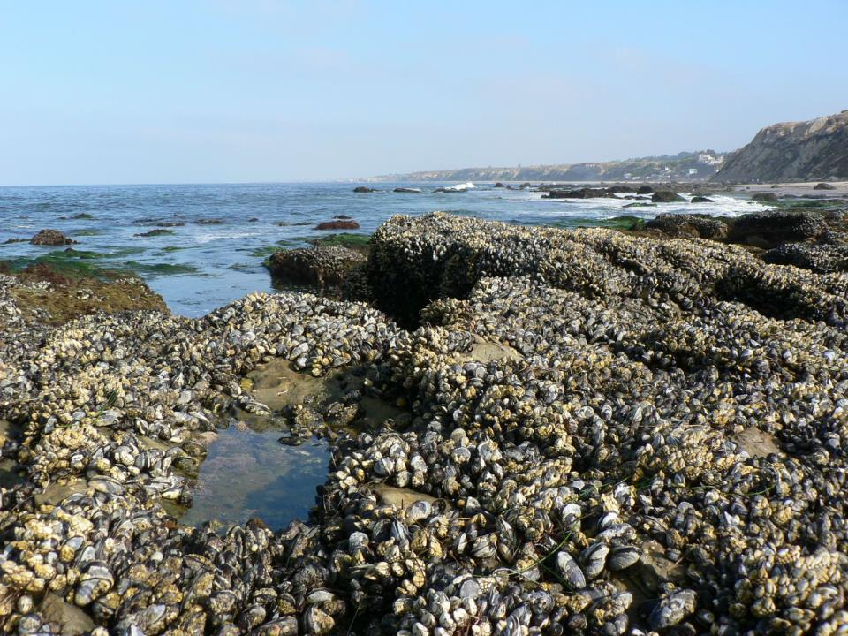
It takes many ingredients
to make a tide pool!
Ocean
Rocky Shore
Pools
Waves and Tides
Sunlight
Plants
Animals
Action: Let’s find more pictures and facts on tide pools
Notes:
Internet Challenge: Students work individually, or in teams or pair, to research and report findings.
Time: 10 minutes to prepare and 2 minutes to share.
Scaffolding: For high-level challenge, have students create their own PowerPoint, Keynote, or Movie using mobile devices and apps.
For ELL or Special Education: Find three facts about 1-2 animals in a tide pool, draw a picture or create a poster.
Everyone: Share with others or post on the wall or class webpage!
If there is no internet access, you can assign homework or plan a trip to the library or computer lab.

Slide 8
Visit tide pools at California State Parks
California Tide Pools Maps Search
California Tide Table link
Notes:
Click on the logo to go to www.parks.ca.gov
Click on the yellow California Tide Pools link to find tide pools in California State Parks.
Click on the California Tide Tables link to study tides in your area and compare to areas across the state.

